Slide 1
Performance Measures of Database Types and Transformation Solutions in ETL Pipelines
Jeff Nguyen and Reannan McDaniel

Slide 2






Executive Summary
Purpose
Explain project motivations
What is Extract, Transform, and Load (ETL)?
ETL overview and explanation
State Hypotheses
Experiment Set-up and Methodology
Data
Experiment set-up
Metrics
Execution
Results
Conclusions

Slide 3
Purpose
Identify storage and data transformation solutions that minimize resource usage.
Notes:
Combinations used for this project:
MySQL – Pandas/cuDF – MySQL
NoSQL – Pandas/cuDF – NoSQL
We want to compare differences between MySQL vs. NoSQL; and Pandas vs. cuDF

Slide 4
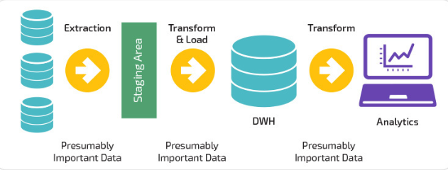
What is ETL?
Extraction, transformation, and loading is a process used to get raw data into a state that is easily accessible and useable.
Extraction
Extraction involves moving data from a database into a data transformation environment
Transformation
Transformation is the process used to prepare data for loading into a database
Loading
Loading takes transformed data and moves it into a data warehouse or data lake
Notes:
This process can be demanding and may require larger amounts of resources as the volume of data increases.
More storage space
Man hours for ETL maintenance
-Transformation:
Systems require data to be in a certain form, the transformation step of ETL prepares that data for the target system
-Loading:
Loaded data may or may not be normalized based on business requirements
Data is usually extracted from a database into pandas, R, or other data manipulation environment
Several examples of 3rd party ETL processes are:
Informatic PowerCenter
Azure
Apache Camel/Kafka

Slide 5


What is ETL: Storage Solutions
MySQL
Open-source (free)
Web-based
Scalability
Data is presented in tables and rows.
MongoDB
Uses JSON-like documents
Open source
Scalability
Data is in collections
Notes:
MySQL is a open-source, web-based, relational database management system initially released in 1995. MySQL is known for scalability – meaning it can be used for small or large datasets. MySQL is unique from other SQL RDBMS because it is open-source, or free.
MongoDB is a NoSQL database that uses JSON-like documents instead of entity tables like RDBMS. There is greater flexibility with scalability in NoSQL databases such as MongoDB. The data is displayed in collections.

Slide 6


What is ETL: Pandas & NVIDIA RAPIDS
Several packages exist for data manipulation and transformation, but for this project we will focus on python packages:
Pandas
This python package is designed for data manipulation
One of the most popular data manipulation packages in use
NVIDIA RAPIDS (cuDF)
NVIDIA RAPIDS is an open source suite of GPU optimized data manipulation, visualization, and machine learning libraries
cuDF is the GPU analog of pandas
Takes advantage of GPU parallelism and dedicated high bandwidth GPU memory
Syntax is nearly identical to pandas
Requires a NVIDIA Pascal+ GPU
Notes:
Pandas’ inbuilt functions that allow for data to quickly be cleaned, modified, and analyzed
- Used in a python environment
Common data manipulation tool like
Dplyr
Open source Python data manipulation library
Contains many inbuilt functions
Allows users to take advantage of a GPU’s thread count and high bandwidth dedicated memory
cuDF is a data manipulation library
NVIDIA RAPIDS is an open-source suite of data manipulation and machine learning libraries
Optimized for use with GPUs
Syntax is nearly identical to Pandas

Slide 7





Hypotheses
We expect MySQL to take longer in read/write operations compared to NoSQL
Transformations may take longer in NoSQL as there is a potential for duplicate data
cuDF will outperform Pandas in data transformation
Notes:
Since the data is normalized, in MySQL we expect the transformation process to work faster than in NoSQL.
Modification of data in MySQL will occur in one location (a tabular relational database) for normalized data
Modification of data in NoSQL requires referencing multiple documents
However, the read write process would take more time in MySQL than NoSQL due to:
ACID compliant properties required in relational databases.
Note about cuDF
note

Slide 8
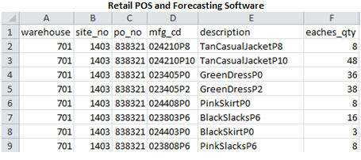
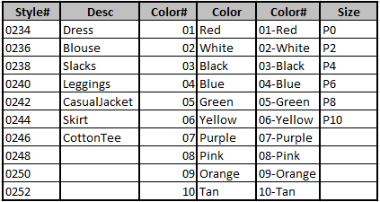
Experiment Set-up : Data
Kelly-Moore Paints Company provided data for this analysis
Transform 406 paint SKUs from paint to 406 SKUs for a women's boutique clothing line
The schema used is a combination of article type, color and size
Proprietary information was removed from the dataset
Notes:
Kelly-Moore Paints data pulled from data warehouse
Data needed to be reverse engineered into it’s normal form
This is done to test extraction and transformation phases of ETL
The data is generated from 2 sources
Retail Point of Sale
Forecasting software
The data is comprised of:
Order recommendations – at the site level
Actual sales – at the site level

Slide 9
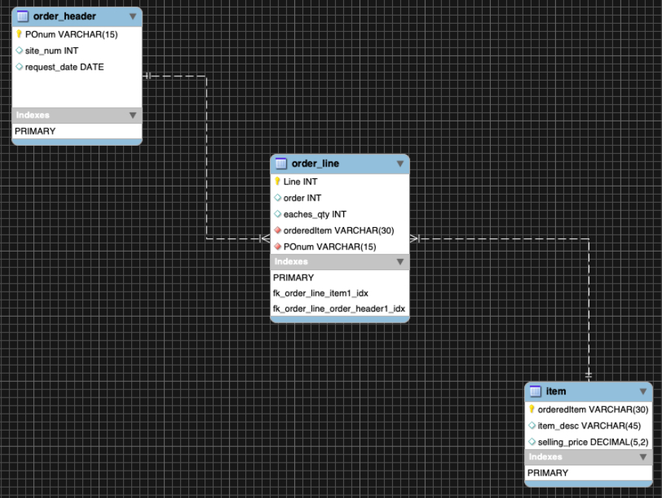
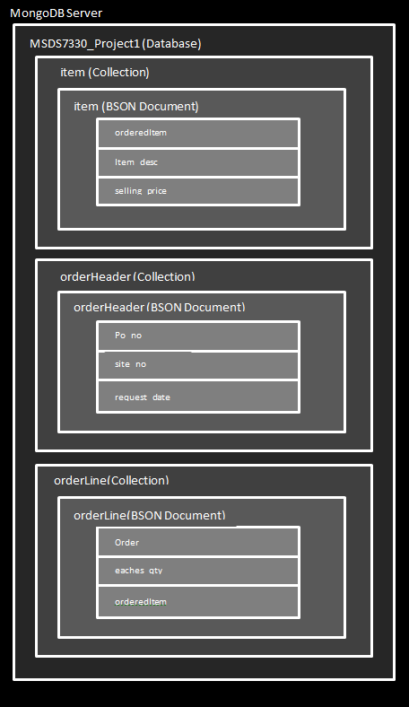
Experiment Set-up: Database Models
MongoDB
MYSQL
Notes:
Data is in the process of normalization

Slide 10
Experiment set-up: Software
OS and Transformation
Extraction and Loading
Ubuntu 18.04 LTS
MongoDB 4.2
MongoDB Compass 1.20.5
MySQL 8.0.19
MySQL Workbench 8.0.19
Python 3.7.0
Jupyter Notebook 6.0.3
Pandas 1.0.3
cuDF 0.8
Cuda Toolkit 10.2
Rstudio 1.2.5033
R 3.6.3
Software Open During ETL
2 Internet Browser Tabs
DB Application
Excel
Zoom
File Explorer

Slide 11
Experiment set-up: Hardware
AMD Ryzen 9 3900X
32GB RAM
NVIDIA 2070 Super
500GB NVME m.2 SSD

Slide 12
Experiment Methodology
Measuring ETL Performance
Performance metrics such as: CPU usage, RAM usage, and time to execute operations will be captured
Metrics will be captured at the following points in the ETL process:
Reading in data from database
Execution of transformation code
Loading of data into data warehouse
Notes:
We expect the execution of transformation and loading of data to be the slowest portion of the ETL process
This is because:
Depending on complexity, transformation may require more computational resources
Writing data to storage is a slow process
Switch off to Jeff

Slide 13
Experiment Methodology: Treatments
Light ETL
Items table extracted to Jupyter Notebook (400 rows) from MySQL and MongoDB
Clothing items with “Blue” in description were changed to “Navy” using Pandas and cuDF
Transformed data was then loaded into MySQL and MongoDB
Medium ETL
Order_line and item tables were joined in MySQL then extracted to Jupyter Notebook (240k+ rows)
For MongoDB extraction, tables were pulled separately then joined in Juypter Notebook
Clothing items with “Blue” in description were changed to “Navy” using Pandas and cuDF. A calculated column for price and quantity was also created
Data was then loaded into MySQL and MongoDB
Heavy ETL
Order_header, order_line, item tables were joined in MySQL then extracted to Jupyter Notebook (240k+ rows)
For MongoDB extraction, tables were pulled separately then joined in Juypter Notebook
Clothing items with “Blue” in description were changed to “Navy” using Pandas and cuDF. A calculated column for price and quantity was also created
Data was then loaded into MySQL and MongoDB
Notes:
Two ETL combinations:
MySQL – Pandas/cuDF – MySQL
Mongo – Pandas.cuDF – Mongo
Both combinations have light, medium and heavy workloads
Light
Smallest table with 406 rows
One string transformation
Medium
Order_line and item talbes joined at 240K rows
One string transformation
One calculated column
Heavy
All tables joined (240K rows)
two string transformations
One calculated column price * quantity

Slide 14
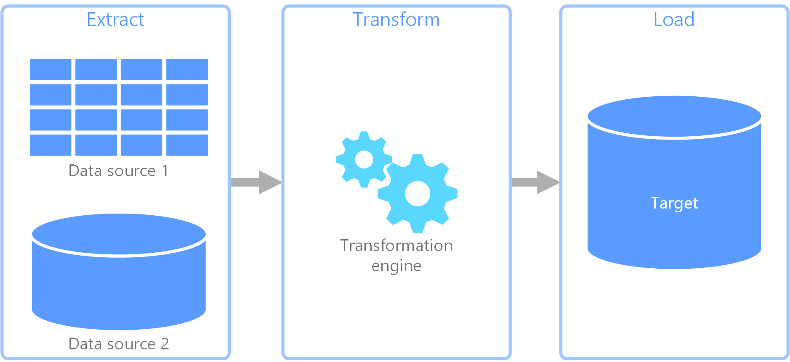
Experiment Methodology: Data capture
x 6 = 720
(
n = 30
+
n = 60
+
n = 30
)
A for loop was used to iterate through each ETL process with a 5 second break between samples to allow for the system to return to base utilization.
i.e. for the “Light ETL” 30 samples were captured for extraction, 60 samples for transformation (pandas and cuDF), and 30 for loading
CPU and RAM base utilization were captured before process execution
CPU and RAM levels are sampled immediately after process is completed
Sample CPU and RAM utilizations were subtracted from base utilization to derive utilization due to ETL processes
Notes:
For light, medium and heavy workloads:
30 samples were taken from extraction (MySQL or MongoDB)
60 samples were taken for transformation (pandas and cuDF)
30 samples were taken for loading (MySQL or MongoDB)
Sampling methodology:
Base CPU and RAM utilizations were taken right before a process was executed
Right afterwards a CPU and RAM utilization sample was taken
Base utilization subtracted from sample to get process utilization
Photo cred: https://docs.microsoft.com/en-us/azure/architecture/data-guide/relational-data/etl

Slide 15
Experiment Execution: Problems encountered?
Working with Databases
Granting write privileges in MySQL
Setting buffer length and packet sizes in MySQL
Normalizing Data in MySQL
Transferring data to and from databases
Installing Drivers for cuDF use
Notes:
Problems we encountered working on this project included:
Working with Databases
Setting up security settings: granting write privileges in MSQL for taking data in via scripts: using the data import wizard solved this quickly
Setting buffer length and packet sizes in MySQL to prevent time-outs
Transferring data to and from databases
- Understanding how to use, set up, and troubleshoot pandas functions
Installing Drivers for cuDF use
- Correctly installing drivers and CUDA toolkits – new to Ubuntu so system would not be stable at times
I’m excited to share the results on these following slides – we found some interesting

Slide 16
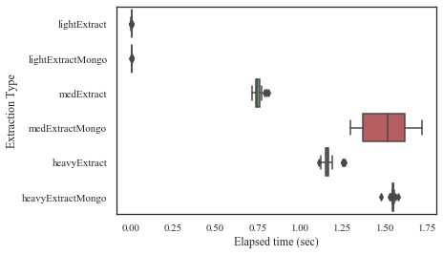
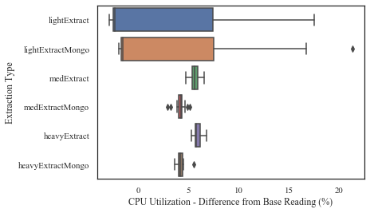
Results: Extraction
Extraction Elapsed Time
Extracting from MySQL could be faster than MongoDB
Elapsed time suggest MySQL is faster than MongoDB for medium and heavy workloads
CPU utilization is higher for MySQL for both medium and heavy workloads
CPU Utilization
Notes:
For extraction:
Top plot is extraction elapsed time
Lower plot is CPU Utilization
MySQL is faster than MongoDB for medium and heavy workloads at the expense of CPU utilization

Slide 17
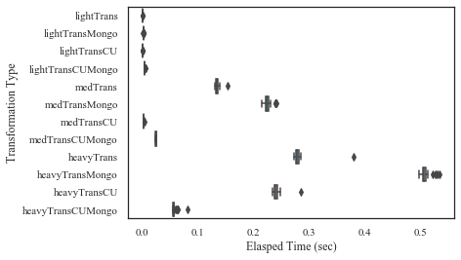
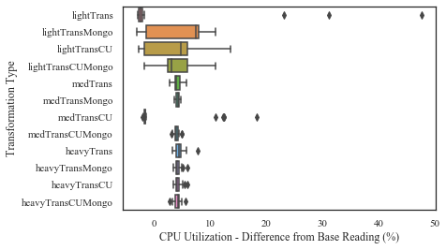
Results: Transformation
Transformation Elapsed Time
cuDF shows significantly faster transformations for some work loads
For medium and heavy workloads cuDF out preforms pandas by a large margin
This holds true regardless of extraction database
Database type appears to have an impact on transformation durations
CPU Utilization
For medium and heavy workloads MySQL extractions allows for faster transformations
This may be due to strict enforcement of data types during schema design
Notes:
For transformation:
cuDF outperformed pandas by a large margin
Data extracted from MySQL was al transformed more rapidly than NoSQL data
Probably due to data type be preset in schema design of MySQL environments
All documents in MongoDB are by default “objects”
Data types needed to be cast to documents

Slide 18
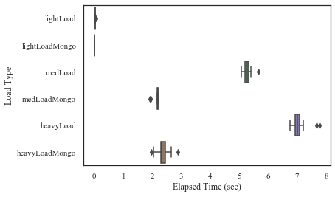
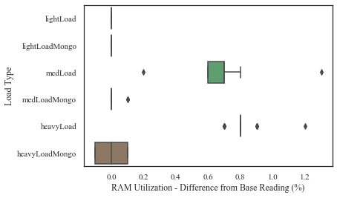
Results: Loading
MongoDB is significantly faster for loading Data
For medium and heavy workloads MongoDB out preforms MySQL by a large margin
For medium and heavy workloads MongoDB also uses less RAM resources than MySQL
Notes:
For loading:
MongoDB is vastly faster than MySQL in loading
RAM utilization for MongoDB was less than MySQL for Medium and Heavy workloads

Slide 19
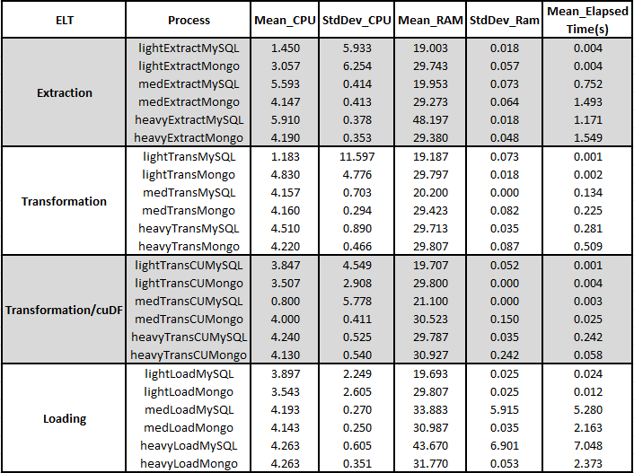
Statistics
Extraction: Elapsed time and CPU
The mean elapsed time for medium and heavy work loads are faster in MySQL than MongoDB
CPU utilization is 8.5% better for the medium work load and 27.5% better for the heavy work load in MongoDB – while MySQL performed 33.9% better in the light work load
Transformation: pandas and cuDF
For medium and heavy workloads cuDF out preforms pandas by a large margin in both MySQL and MongoDB
Loading: RAM usage
Statistically MongoDB out preformed MySQL in the medium workload by 25.9% and 29.1% in the heavy workload
Notes:
Extraction:
MySQL is faster
But MongoDB takes less CPU resources
Transformation
cudDF outperforms Pandas by a large margin for data extracted from both MySQL and MongoDB
Comes at a very slight expense to RAM
4x faster for heavy workloads
Loading
MongoDB is at least 2x as fast as MySQL in loading for our workloads

Slide 20

Conclusion
MySQL outperformed MongoDB in read operations for medium and heavy workloads and they performed the same for light workloads.
Transformations took more time in MongoDB for data extraction compared to MySQL.
cuDF outperformed pandas in all workloads for both MySQL and MongoDB
Notes:
Thank you everyone for being here
We hope these findings provide some useful information that can possibly save you some time
At this time we will take questions

